Slide 1
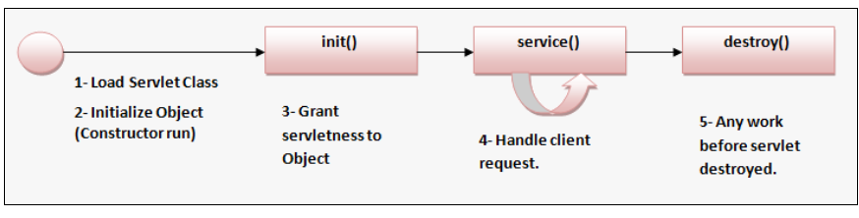
Servlet Life Cycle -
A Servlet goes through the following stages in its life time -
1 - Load class -
Web container finds the servlet class file and load it. This is from where servlet life cycle starts
2- Servlet Object created -
A default constructor instantiate the servlet object. You do not need to run this constructor, it is by default executed by your compiler.

Slide 2
3- init() method called -
init() method allows you to initialize your servlet before it service any client request. It runs only once in servlet lifecycle. And it must completed before service() method is called.
Syntax -
public void init(ServletConfig sc)throws ServletException
{
}
Here sc is a ServletConfig object that contain servlet configuration and initialization parameters information.
As Servlet is intialized it gives you -
a- javax.servlet.ServletConfig object - For each Servlet, seprate ServletConfig object is created. We can use it to pass deployment time information to Servlet.
b - javax.servlet.ServletContext object- One ServletContext is created for your application. We can use it to share data (attributes) between different Servlets.

Slide 3
4- service() method called -
It generate the response for client request. It is called each time when a request is made for the servlet.
It has the following syntax
public void service(ServletRequest request, ServletResponse response)throws ServletException, IOException
Where -
request - is a ServletRequest object that contain request made by client.
response - is a ServletResponse object that contain response generated by servlet for the coming request.
5- destroy() method called -
It is called just before Servlet destroyed. It allows us to do some work that we want to do before Servlet has destroyed (for example closing a stream).After destroy(), Servlet becomes eligible for garbage collection.

Slide 4
Deployment Descriptor (web.xml) welcome-file-list :-
web.xml has an element named "welcome-file-list" that is used to define welcome page or default page for your project. It contains a sub element named "welcome-file", where you can define multiple welcome files for your project.
How it works? - If client make a request to server without specifying any file name, then server will invoked this "welcome-file-list" to send specified welcome file in response to client.
When a request comes in to server without any file request, server looks for the file to be send in response, in the following order -
1 - welcome-file-list in web.xml
2- index.html
3- index.htm
4- index.jsp
5- default.html
6- default.htm
7- default.jsp
If we our project have all the above files, then priority will be of welcome-file-list.
If welcome-file-list is not there then priority will be of index.html and so on.

Slide 5
Example -
In this example our default page will be test.html in place of index.html.
1 - index.html file within WEB-INF -
<html>
<head>
<title>TODO supply a title</title>
<meta charset="UTF-8">
<meta name="viewport" content="width=device-width, initial-scale=1.0">
</head>
<body>
<h1>Welcome to index.html page</h1>
</body>
</html>

Slide 6
2- Create a "test.html" file within WEB-INF -
<html>
<head>
<title>TODO supply a title</title>
<meta charset="UTF-8">
<meta name="viewport" content="width=device-width, initial-scale=1.0">
</head>
<body>
<h1>Welcome to test.html page</h1>
</body>
</html>

Slide 7
3- In web.xml file enter the following code within web-app -
<welcome-file-list>
<welcome-file>test.html</welcome-file>
</welcome-file-list>
4- Now run your project. And you will see that your default page will be now test.html in place of index.html.

Slide 8
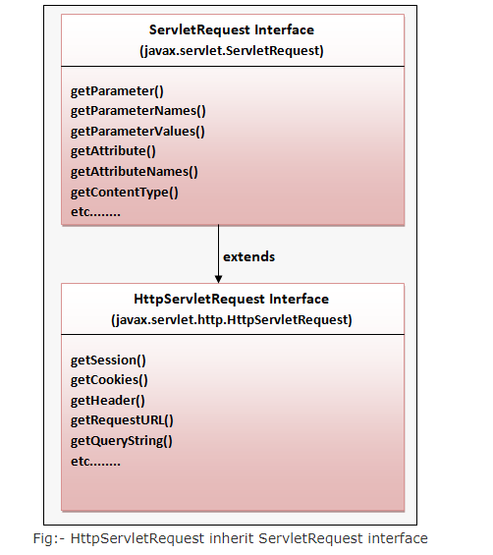
ServletRequest and ServletResponse -
avax.servlet.ServletRequest and javax.servlet.http.HttpServletRequest Interfaces -
Servlet container creates ServletRequest or HttpServletRequest objects that provides client browser request information to server. ServletRequest and HttpServletRequest contains several methods that we can use to get client data.

Slide 9
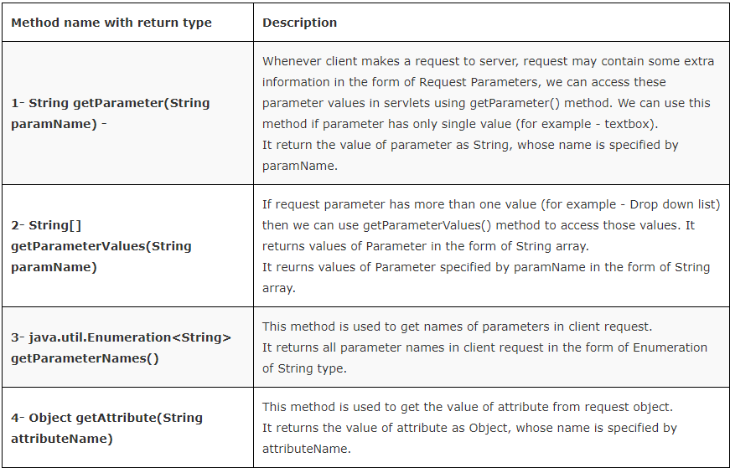
ServletRequest Methods -
Some important methods of ServletRequest are as follows -

Slide 10
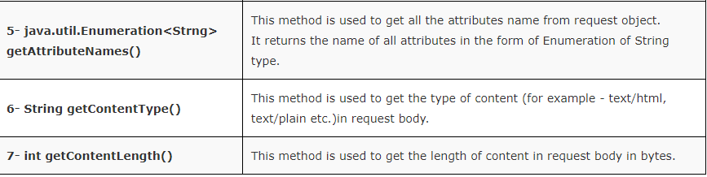
Example -
This example will show you the working and use of different methods of ServletRequest -
1- index.html or index.jsp - This will be your default page.
<body>
<form method="post" action="MyServlet1">
Enter your name: <input type="text" name="name" placeholder="your name"><br><br>
Enter your hobbies:
<select name="hobbies" multiple size="3">
<option>Playing Cricket</option>
<option>Playing Football</option>
<option>Playing Hockey</option>
<option>Traveling</option>
<option>Singing</option>
</select><br>
<input type="submit" value="Submit">
<input type="reset" value="Reset">
</form>
</body>

Slide 11
2- MyServlet1 - Create a Package named "servs" and within "servs", create a Servlet named "MyServlet1"
package servs;
import java.io.*;
import javax.servlet.*;
import javax.servlet.http.*;
public class MyServlet1 extends HttpServlet
{
public void doPost(HttpServletRequest request, HttpServletResponse response) throws ServletException, IOException
{
try
{
PrintWriter out = response.getWriter();
// Accessing Textbox value from request.
String nm = request.getParameter("name");

Slide 12
// Accessing selected list values from request.
String[] hb = request.getParameterValues("hobbies");
// Accessing names of all parameters available in request.
java.util.Enumeration<String> paramNames = request.getParameterNames();
//Accessing MIME type of request body.
String cntype = request.getContentType();
//Accessing size of content in request body.
int size = request.getContentLength();
out.println("Employee :- "+nm+ "has the following hobbies:-");
for(String h:hb)
{
out.println(h);
}

Slide 13
out.println("Parameter Name are - ");
while(paramNames.hasMoreElements())
{
String pn = paramNames.nextElement();
out.println(pn);
}
out.println("Content type is:- "+cntype);
out.println("Content Size is:- "+size+" bytes");
}
catch (Exception ex)
{
System.out.println(ex);
}
}
}

Slide 14
3- web.xml - Add the following code to web.xml within web-app
<servlet>
<servlet-name>demo</servlet-name>
<servlet-class>servs.MyServlet1</servlet-class>
</servlet>
<servlet-mapping>
<servlet-name>demo</servlet-name>
<url-pattern>/MyServlet1</url-pattern>
</servlet-mapping>

Slide 15
3.1 - Use of Annotation in place of web.xml for Servlet Mapping -
Java defines a package named "javax.servlet.annotation" that provides us various annotations we can use to declare servlet, listeners, filters etc.
For servlet mapping, it defines a annotation named "javax.servlet.annotation.WebServlet". We can use it to define url pattern of our servlet. This annotation gets processed by web container at the deployment time of our servlet.
To use annotation make the following changes to "MyServlet1" servlet -
package servs;
import java.io.*;
import javax.servlet.*;
import javax.servlet.annotation.WebServlet;
import javax.servlet.http.*;
@WebServlet("/MyServlet1") // /MyServlet1 will be url pattern of this servlet
public class MyServlet1 extends HttpServlet
{
public void doPost(HttpServletRequest request, HttpServletResponse response) throws ServletException, IOException
{
............................................... same as previous

Slide 16
Now we do not need to add servlet information in web.xml file.
4- Now run your project, and it will show you index.html page, enter your choices.

Slide 17
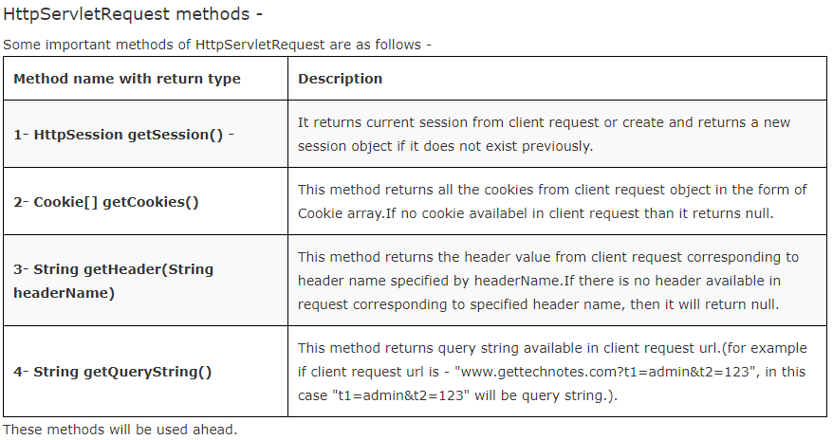

Slide 18
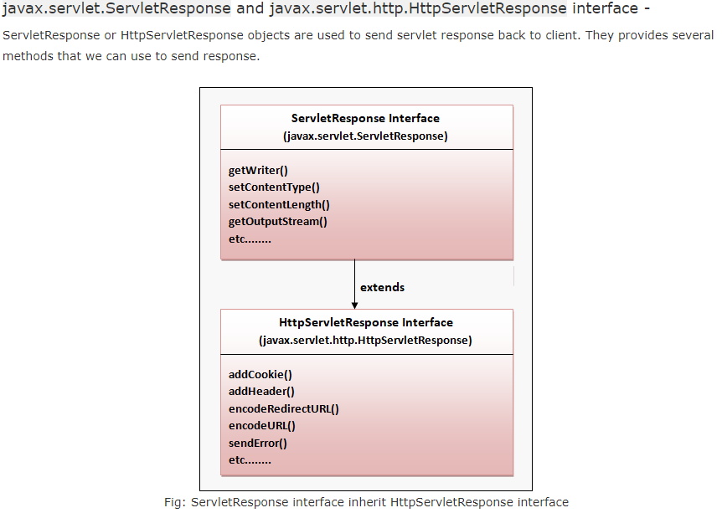

Slide 19
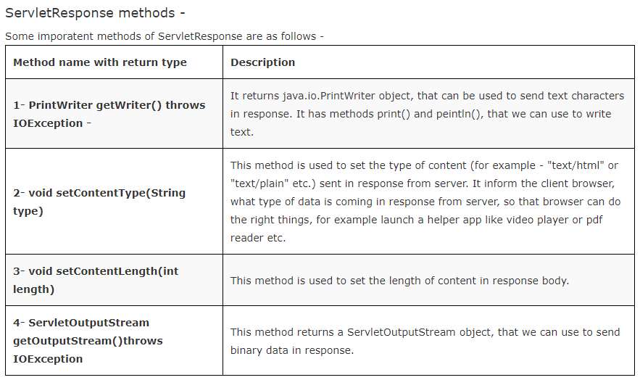

Slide 20
